Slide 1
Introduction to KeyStone Software ECO

Slide 2
Agenda
Characteristics of modern operating system and development environment
TI traditional support for development
DSP BIOS
Frameworks, utilities and drivers
The ECO system
Multicores development support
MCSDK
Multicores ECO system

Slide 3
Think about Your Favorite Operating System
Provide scheduling – multiple thread co-exist
Provide standard API for utilities
Print
Networking (sockets)
Time, and many more
Hides the hardware and driver details from the application
But if you look under the hood:
There are actual hardware modules and interfaces (the manufacturer)
A set of LLD to talk to the hardware
One or more layers of utilities APIs that connect the application to the LLd
And when you develop code:
IDE
Libraries

Slide 4
TI traditional Support
DSP BIOS Real-Time operating system
Scheduling (Hardware interrupt, SWI, task)
Memory management
Communications
Performances monitoring
Standard API and optimized libraries
Frameworks
Easy access to peripherals and other resources (dma)
Hiding hardware implementation from the application (CSL)
IDE
Code composer studio
Code generation tools
Debug, emulation, monitoring, profiling

Slide 5
KeyStone Architecture Challenges
Even though KeyStone has a lot
Advanced core performances
Support multicores architecture
Multiple internal resources
Many peripherals and co-processors
The challenge
Make it easy for the programmer to develop optimized application

Slide 6
Software Development Ecosystem Multicore Performance, Single-core Simplicity
Eclipse
Code
Composer
StudioTM
Third
Party
Plug-Ins
Editor
PolyCore
CodeGen
OpenMP
ENEA
Optima
Multicore Software Development Kit
Profiler
3L
Debugger
Critical
Blue
Remote
Debug
Multicore System
Analyzer
Visualization
Host Computer
Target Board
XDS 560 V2
XDS 560 Trace

Slide 7
Improvements to the IDE
Eclipse based CCS 5 supports multiple cores and multiple devices
Multiple windows
Open source – third party plug in
Three run conditions
Advance debugging, monitoring and profiling
Optimized compiler/optimizer/assembler/linker
openMP support
Multiple configurations for the same project, can generate single executable or multiple executable for the same project
GUI interface for SysBios, project based system to build drivers and utilities for user target system

Slide 8
Multi-Cores System Needs
Ability to configure and use peripherals and other hardware resources
Standard and easy to use API to use peripheral, accelerators and other hardware resources. Standard access to external worlds
Easy to use software to boot, test, debug and monitor the execution
Individual core real-time operating system
Easy and efficient software to communicate between cores and facilitate co-operation between cores and between peripherals and cores
Optimized, ready to use libraries, application examples, demos
TI solution – Multi-layers Software System
MCSDK

Slide 9
What is MCSDK?
The Multicore Software Development Kit (MCSDK) provides the core foundational building blocks for customers to quickly start developing embedded applications on TI high performance multicore DSPs.
Uses the SYS/BIOS or Linux real-time operating system
Accelerates customer time to market by focusing on ease of use and performance
Provides multicore programming methodologies and utilities
MCSDK makes it easy to port new application into standard target, port software from standard target to customer’s target, and porting application to the next generation hardware
Available for free on the TI website bundled in one installer, all the software in the MCSDK is in source form along with pre-built libraries

Slide 10
Challenges and Solutions (1)
Hide the hardware details from the user. Make it easy to port to a new hardware | The CSL layer provided by TI is the only layer that depends on the hardware. This layer is completely transparent to the user/application
Standard API to talk to peripherals, accelerators and other resources | Low-Level drivers (LLD) provide standard API to initialize, configure and use peripherals and other resources. LLD blocks include SRIO, PCIe, PA, CPPI, QMSS, FFTC and many more
Utilities to facilitate system working | Platform software provide utilities such as boot loader, Power On Software Tests, resource manager and platform utilities
Efficient real-time individual core operating system | Sys Bios is the new version of DSP Bios, low foot-print efficient mature operating system
Easy interface to the external world | Communication Protocols (TCP/IP Networking NDK modules) provide standard easy usage of common protocols

Slide 11
Challenges and Solutions (2)
Multiple cores co-working | IPC layer provide several high level utilities and libraries to communicate between cores and enable multiple cores working together.
Facilitate application development | Optimized algorithm libraries with standard APIs,
Application Development starting point | Demonstration applications layer show how to build and run a complete application.
Multicores scheduling system | Open Even Machine (OEM) is a firmware based (PDSP) global schedule execution management that supports load balancing and global priorities scheme

Slide 12
MCSDK Software Layers
Demonstration Applications
HUA/OOB
IO Bmarks
Image
Processing
Software Framework Components
Communication Protocols
SYS/BIOS
RTOS
Interprocessor
Communication
Instrumentation
(MCSA)
TCP/IP
Networking
(NDK)
Algorithm Libraries
Platform/EVM Software
DSPLIB
IMGLIB
MATHLIB
Platform
Library
Transports - IPC - NDK
Low-Level Drivers (LLDs)
Resource
Manager
POST
EDMA3
PA
SRIO
FFTC
TSIP
OSAL
Bootloader
PCIe
QMSS
CPPI
HyperLink
…
Chip Support Library
Hardware

Slide 13
Examples of Software layers - IPC
IPC provide standard interface between thread in the same core, between cores and between devices

Slide 14
Example Interprocessor Communication (IPC)
Device 1
Device 2
IPC Transports | Task to Task | Core to Core | Device to Device
Shared Memory | x | x
Navigator/QMSS | x | x
SRIO | x | x | x
PCIe | x | x | x
HyperLink | x | x | x
Core 1
Core 2
Core 1
Core 2
BIOS
Process 1
Process 2
BIOS
Process 1
Process 2
BIOS
Process 1
Process 2
BIOS
Process 1
Process 2
IPC
IPC
IPC
IPC
SoC Hardware and Peripherals
SoC Hardware and Peripherals
Device 1
Core 1
Core 2
Core 3
Core N
Linux
Process 1
Process 2
BIOS
Process 1
Process 2
BIOS
Process 1
Process 2
BIOS
Process 1
Process 2
SysLink
IPC
IPC
IPC
SoC Hardware and Peripherals

Slide 15
Examples - Easy migration of Application
TI Demo Application on TI Evaluation Platform
TI Demo Application on Customer Platform
Customer Application on Customer Platform
Customer App on Next Generation TI SOC Platform
Demo Application
Demo Application
Customer Application
Customer Application
Tools
(UIA)
EDMA, Etc
Tools
(UIA)
EDMA, Etc
Tools
(UIA)
EDMA, Etc
Tools
(UIA)
EDMA, Etc
Network
Dev Kit
Network
Dev Kit
Network
Dev Kit
Network
Dev Kit
LLD
IPC
TI Platform
LLD
IPC
Customer Platform
LLD
IPC
Customer Platform
LLD
IPC
Next Gen TI Platform
CSL
CSL
CSL
CSL
No modifications required
Software may be different, but API remain the same (CSL, LLD, etc.)
May be used “as is” or customer can implement value-add modifications
Needs to be modified or replaced with customer version

Slide 16
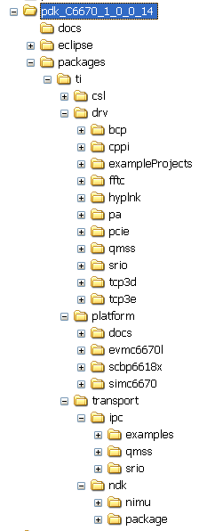
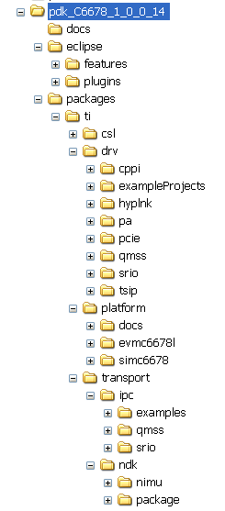
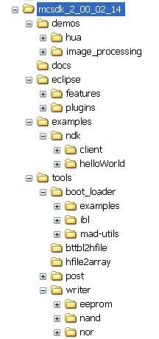
Directory Structure MCSDK, pdk

Slide 17
Directory Structure EDMA, Bios, libraries

Slide 18
Directory Structure IPC, NDK

